Slide 1


Eniac
SISTEMAS INFORMÁTICOS

Slide 2

More discounts means more profit ???

Slide 3
CONTENT
01
Facts
04
Conclusion
02
Revenue Analysis
05
Recommendation
03
Discount Analysis

Slide 4

Facts
93%
Discount products
63.475
Sold products between Jan.2017 and March.2018
8 Mio €
Total Revenue

Slide 5

Revenue Analysis

Slide 6
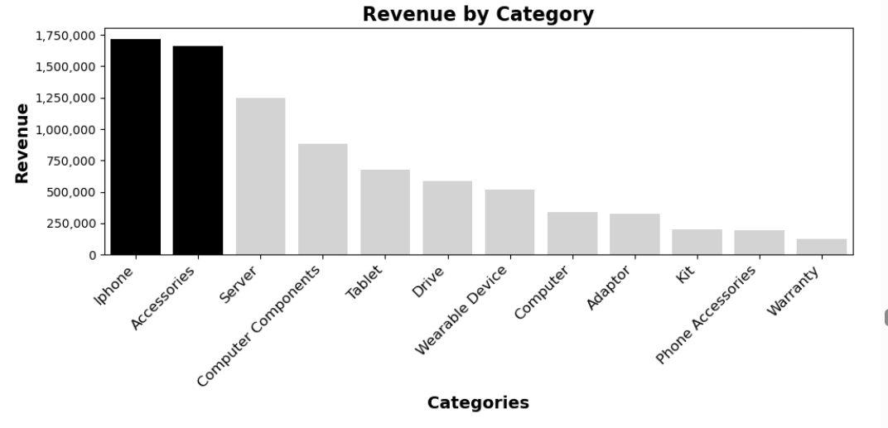
iPhone and Accessories create the highest Revenue

Slide 7
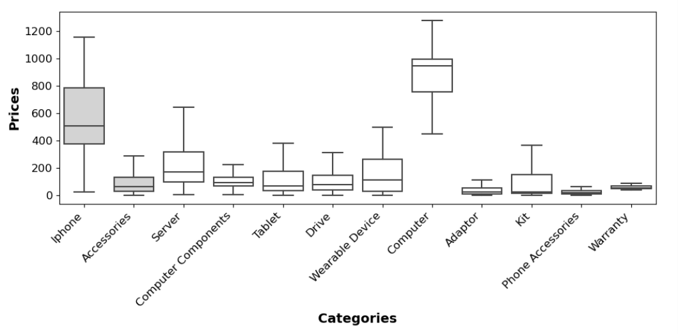
Accessories are also the second top revenue despite it is lower prices

Slide 8
Discount Analysis

Slide 9
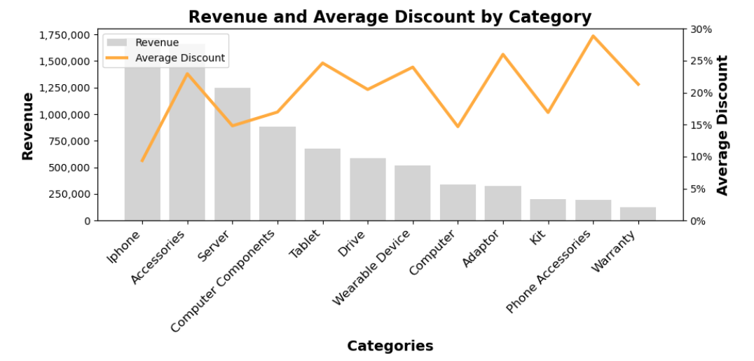
Even aggressive discounts does not add much to the Revenue!

Slide 10
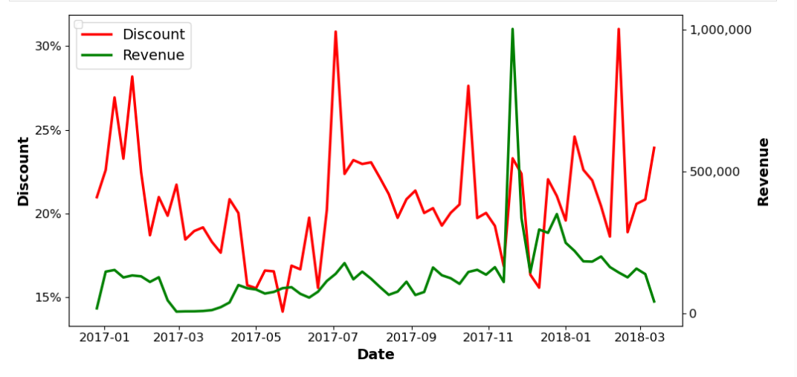
Moderate discounts for special events increased revenue exponentially.
Notes:
Explain the graph starting from

Slide 11
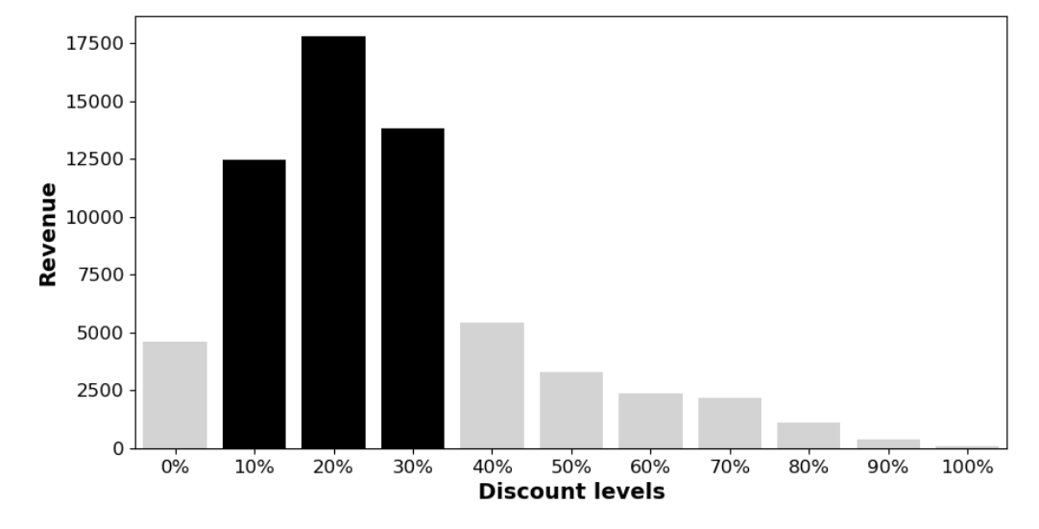
Discount levels VS Revenue

Slide 12
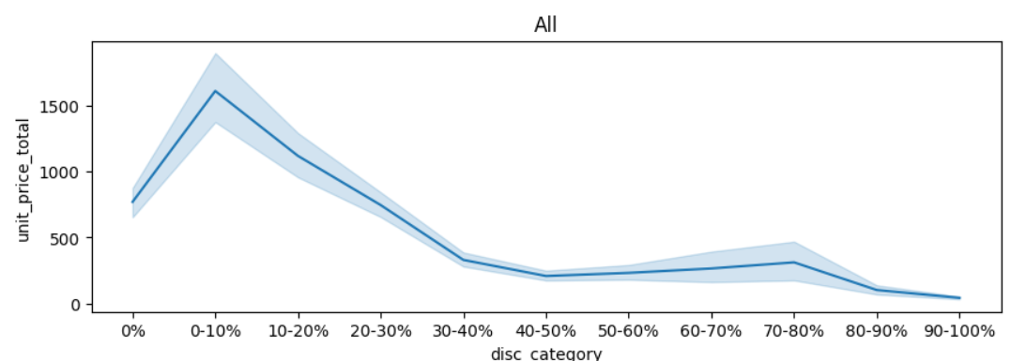
Even aggressive Discounts does not add much to the Revenue!

Slide 13
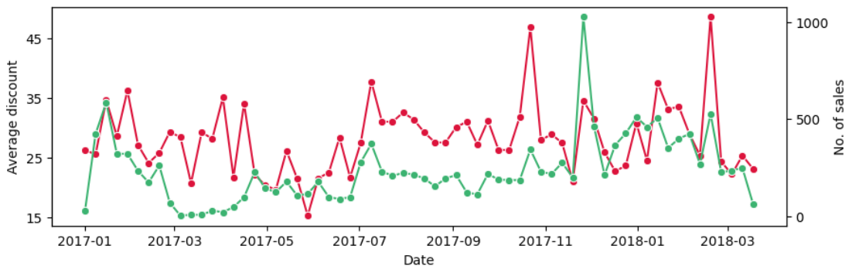
AVERAGE DISCOUNTS VS NO. OF SALES

Slide 14
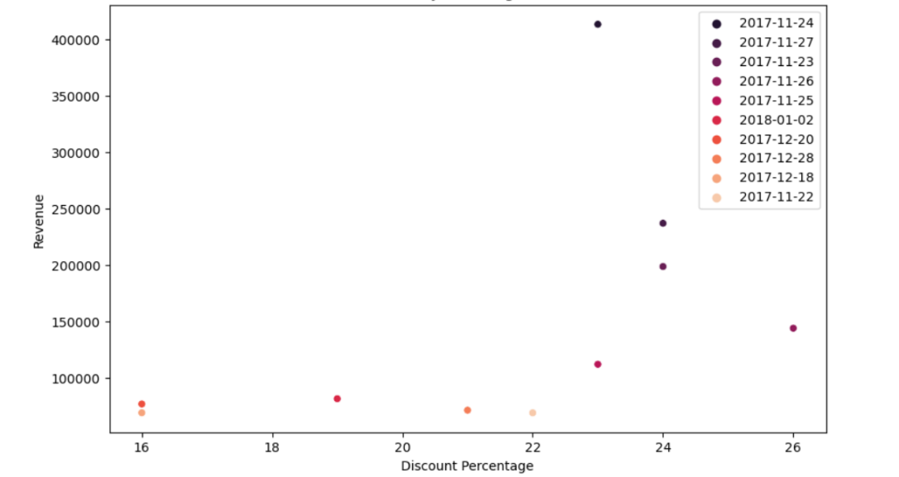
Discounts on 'specific' days with Higest Revenue

Slide 15
Conclusion
&
Recommendation

Slide 16
Are discounts really effective?
Small discounts (0-30%) are currently the most profitable
Avoid aggressive discounts
Targeted special discounts ( special editions / special event)
Products with a strong brand perception (Apple products) are sold regardless of
discounts → Discount not recommended
Lower-priced items (hard drives, accessories) benefit from
discounts → Discount recommended
Notes:
iPhone still high seller and high price product.
up 20% still benefit from the discounts on the accessories

Slide 17
Data Collection
Cost factor?
Customer reviews and ratings of the product?
Price?
Customer ID?
Notes:
Invest more in quality prices

Slide 18
Thank You

